Slide 1
Tableau - Salesdata
File created on: 01-07-2022 15:24:12

Slide 3
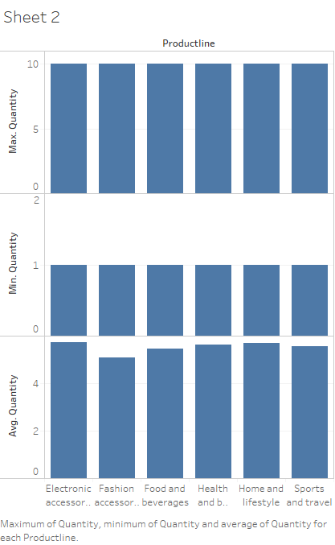

Slide 4


Slide 5


Slide 6


Slide 7
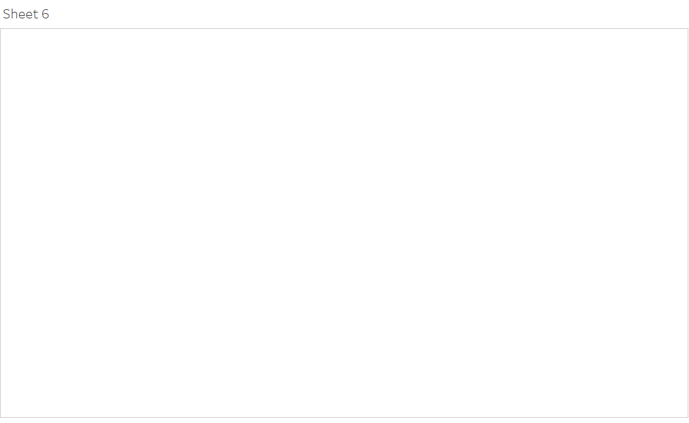

Slide 8


Slide 9


